Slide 1
Exploring how the development of creativity skills, a quality indicator in HGIOS4, can challenge prejudice across all sectors and ages, and hear how creative approaches might inform your work in this area.
Challenging Prejudice Based Bullying through Creative Change
Stephen Bullock, Development Officer, Creativity
Education Scotland

Slide 2
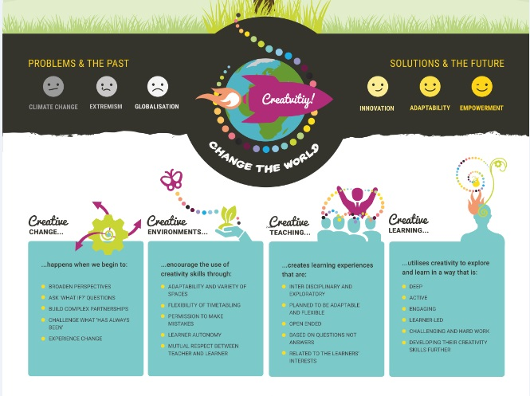

Slide 3
3 Key messages
Developing creativity skills can undermine prejudice at a fundamental level
Developing creativity skills is a responsibility for all and identified by inspectors
By using creative approaches the solutions to prejudice based bullying can be unexpected
Notes:
Creativity is the hook to engage learners
Creativity is about good teaching and learning

Slide 4
the one-stop shop for creative learning, teaching and partnerships

Slide 5
Notes:
The Creativity Portal deliberately floods you with resources and inspiration to allow you to work creatively and make connections with things you didn’t know you were looking for.

Slide 6
What is creativity?

Slide 7
Notes:
There is a stereotype and an expectation that creativity is something you are born with. You’re just good at. Or not. That perhaps it’s genetic. Maybe it’s a new evolutionary leap, like leaving the rivers and growing legs. This worries me, because I like most of the people I meet and I don’t like the idea of them becoming extinct. You see creativity is a skill and needs taught, explored and practiced like any other.

Slide 8
Eureka!
Archimedes
Albert Einstein
Notes:
If you’re tempted to see creativity as being a Eureka moment, take another look at how all scientists work.
Einstein made a similar discovery – and it’s nowhere near as instantaneous as Eureka.
The point is that Archimedes had been working on the problem for a long time. He had an open mind, a questioning mind, had spent time creating really great questions, and had already rejected other possible answers to the problem. What he did then was to let the idea float around in his head – to gestate.
And then the only piece of magic in the creative process happened. He relaxed. And his brain continued to allow all of those thoughts wander around until a few of them bumped into one another and became an entirely new thought.
They used to think there was a left brain and right brain element to creativity. It’s actually about the number of connections between the two hemispheres – it’s about making connections and working interdisciplinary. Sounds a lot like Curriculum for Excellence doesn’t it.
ALSO the Mozart story about how he wasn’t a genius but had amassed enough practice time by an early age that he was competent enough to compose on a par with those far older.

Slide 9
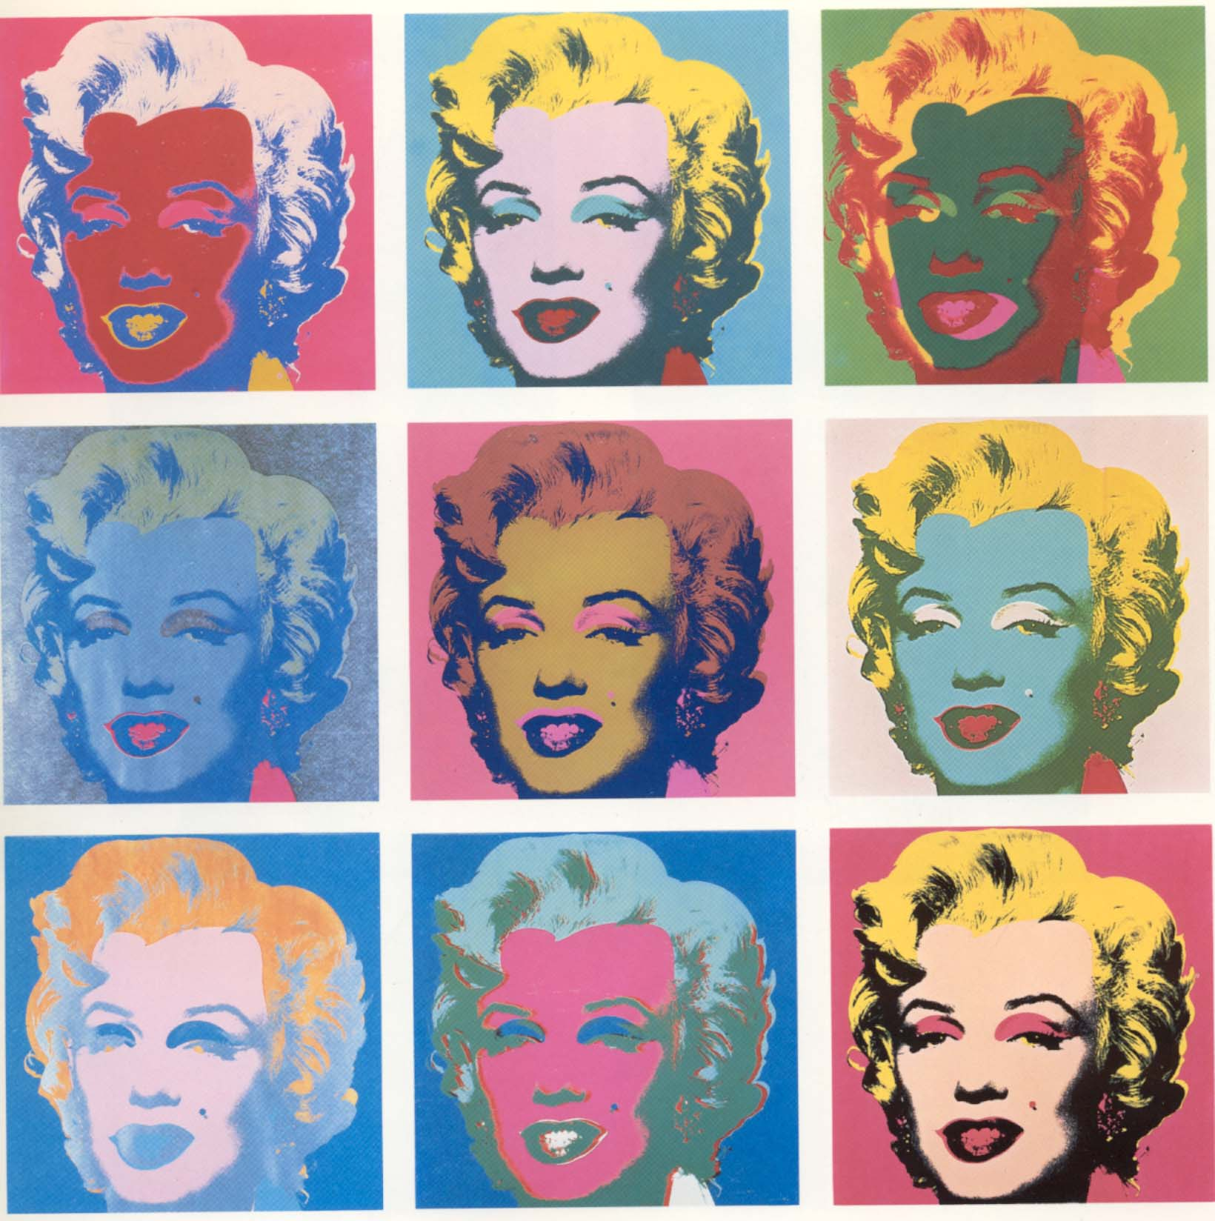
Notes:
Are the Expressive Arts and Creativity the same thing?
Or, can you be creative in other areas of learning?
Are you always being creative when you’re involved in expressive arts activities?

Slide 10
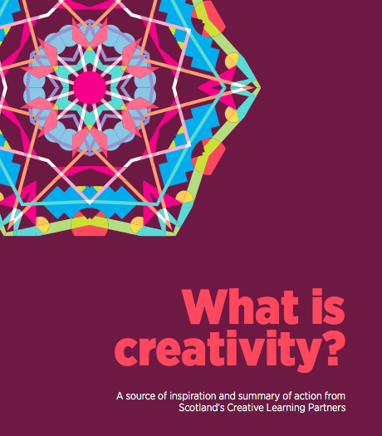
Scotland’s Creative Learning Plan
Share our vision for a more creative society
Build capacity and expertise of learning practitioners to support the development of creativity skills in learners
Develop a strategic approach to pathways for lifelong creative learning
Develop approaches to assessment of creativity, including certification
Scotland’s national Creative Learning Plan is supported by:
Cabinet Secretary for Education and Lifelong Learning
Cabinet Secretary for Culture, Europe and External Affairs
Minister for Learning, Science and Scotland’s Languages
Notes:
Ambitious shared vision for a more creative society – S.Gov (3 ministers) & 7 partners

Slide 11
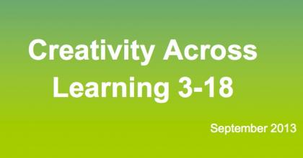
Curriculum Impact Report
What is creativity? What are creativity skills?
Why are they so important?
Are they being developed in schools across Scotland?
Notes:
Creativity is a process which generates ideas that have value to the individual. It involves looking at familiar things with a fresh eye, examining problems with an open mind, making connections, learning from mistakes and using imagination to explore new possibilities
Project methodology
Literature search (e.g. Centre for real-World Learning research)
Discussion with external contacts
Framing of terms of reference
Field visits (approx 40 establishments)
Report drafting and launch

Slide 12
Definitions and key messages
Creativity is a process which generates ideas that have value to the individual. It involves looking at familiar things with a fresh eye, examining problems with an open mind, making connections, learning from mistakes and using imagination to explore new possibilities.

Slide 13
Creativity Skills
The Responsibility of All
Curiosity Open-mindedness Imagination Problem Solving
Creative individuals are confident in their right and ability to influence change

Slide 18
Creativity Skills
Being curious
Registering patterns and anomalies
Drawing on previous knowledge
Researching productively
Formulating good questions
Defining problems
Exploring multiple viewpoints
Functioning with uncertainty
Lateral thinking
Hypothesising
Synthesising and refining multiple options and viewpoints
Inventing
Crafting, delivering and presenting solutions
Applying discipline and resilience
Evaluating impact and success of solutions
Identifying next steps in refinement or development process

Slide 19
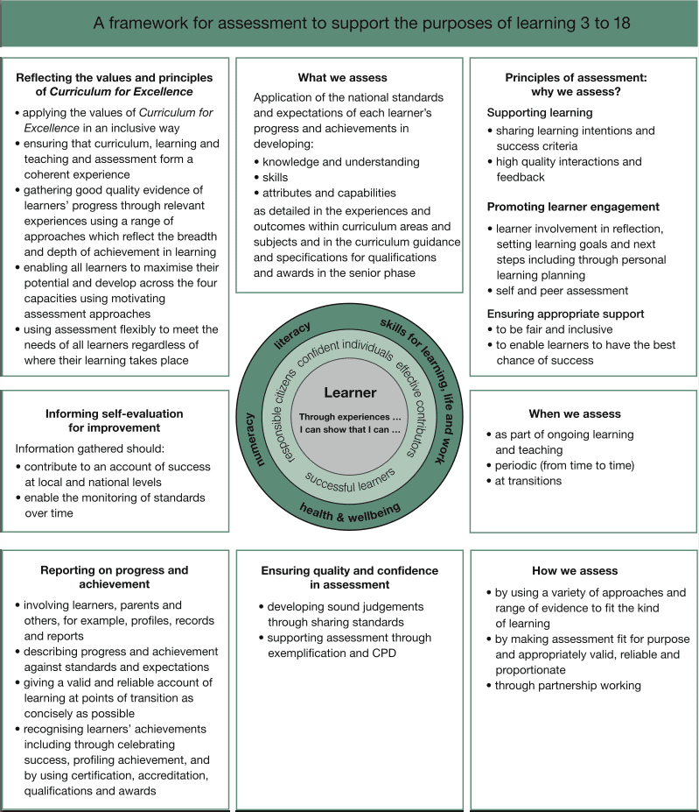
Building the Curriculum 4

Slide 20
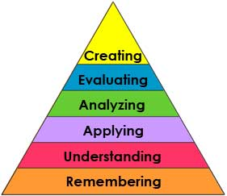
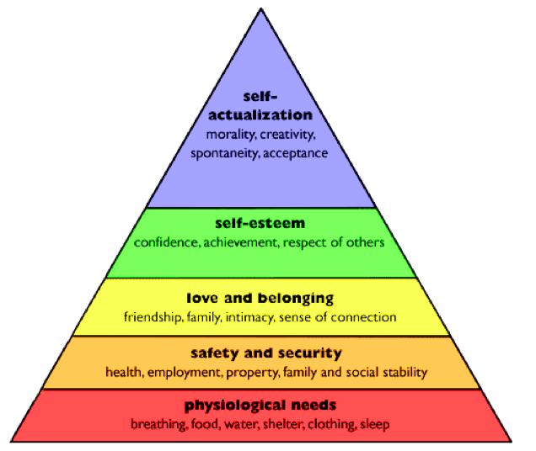
Bloom’s and Maslow’s

Slide 21
Definitions and key messages
Creative Learning: Learners are using their creativity skills
Creative Teaching: Learning providers are using their creativity skills
Creative Change: Using creativity skills for planning and improvement

Slide 22
Notes:
Now we’re going to explore some creativity skills using two creativity toybox exercises from the Creativity Portal – you can Filter for Creativity Toybox to see them all in one place.
The What If? Question is a vital tool in starting the creative process.
Most of them develop divergent thinking – coming up with multiple solutions to a problem can be more valuable than coming up with the one correct answer in developing learners’ skills
Many of them develop convergent thinking – making connections.
They all require analysing, filtering and applying prior knowledge.
They are all able to be run in the classroom with no additional space with any size of group and can last as short or long a time as you wish.

Slide 23
What if... we had 7 fingers and 3 legs?

Slide 24
What do a mouse and a refrigerator have in common?

Slide 25
“ Success in love involves… wisdom, intelligence and creativity. Creativity is needed because relationships and the circumstances in which they unfold change over time. Couples who cannot be flexible in adapting to those circumstances, and to the changes that inevitably happen because of the trajectories of the various components of love are different over time, are more likely to be in failing relationships.”
Robert J. Sternberg
Professor of Psychology and Provost
Oklahoma State University

Slide 26
Do schools kill creativity?
Sir Ken Robinson
Noise Box
Number Sequence
Bureaucracy
Standardisation
Exams
Notes:
Ken robinson says schools are killing creativity... Surely that means that we, the practitioners, have already had our creativity killed?
I would recommend watching the RSA animation of Sir Ken’s TED talk. It’s on the Creativity Portal.

Slide 27
Scotland’s Creative Schools Award
The three finalists
what does a creative school do?
Notes:
Around 15% of the finalists in this year’s Education Awards were from the Special Schools Sector.
Are people (are schools) only creative when they NEED to be?

Slide 28
Dalry Primary School (Edinburgh)
Most Multi-cultural school in Edinburgh
Language and visuals
Every child is a published author
Parental engagement
Arts Hub
Sand
Thorntree Primary School (Glasgow)
Area of deprivation
Traveller children
Vast range of activities
Assemblies!?
Breakfast Club rules
Jobs for all
‘Up for it-ness’
Drummond Community High School (Edinburgh)
National galleries of Scotland project – Ways of Seeing
Sighted and visually impaired students
Guided tour and workshop for younger visually impaired learners
Collaborative learning by educators, learners and audience

Slide 29
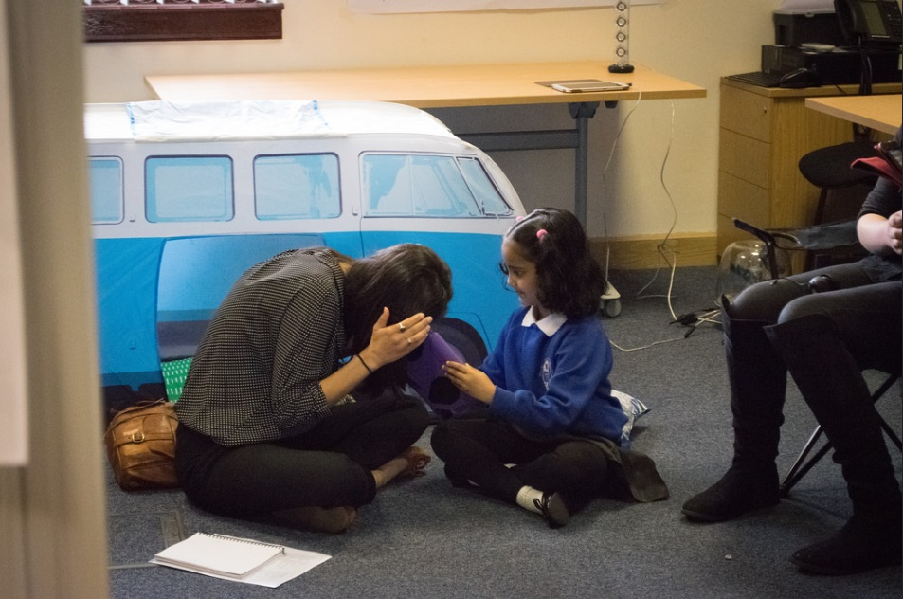
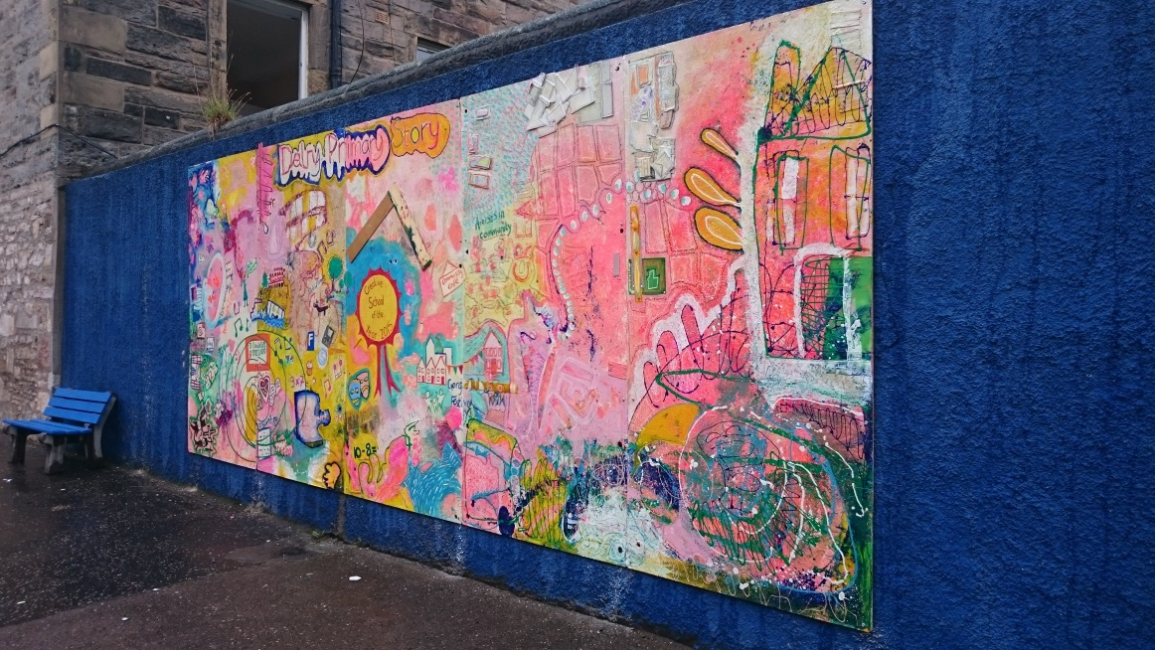
“[The Head Teacher] has a very clear vision about where he wants the school to go and is very creative in his approach. Working with him is like working with an artist - capturing ideas, being realistic about how to make it happen, working with the staff to get them inspired and trying to make projects happen practically - setting up templates, check lists and funding application outlines.”
Creative Catalyst
We now have ideas of trying to turn the school into a Fringe space, creating a tree house internally, a beach and other messy areas that can be used by performers and left for the children to explore and play with.
Educator
https://vimeo.com/123181899
http://www.ripplearts.co.uk/dalry-primary---a-creative-hub.html

Slide 30
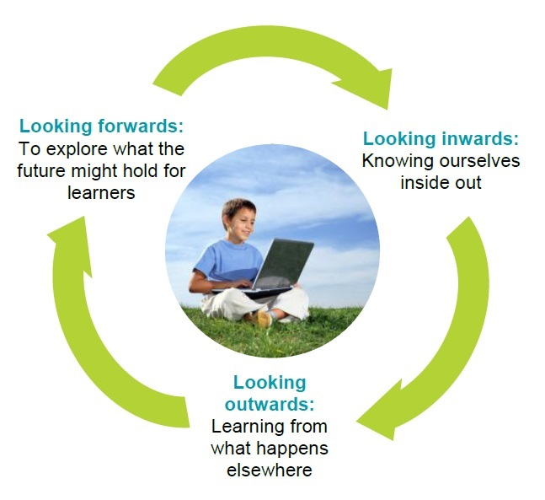
Continuous Improvement

Slide 31
Looking inwards:
to evaluate performance at every level and use the information gathered to decide on what needs to be done to improve.
Looking outwards:
to learn from research, others and best practice and use this to facilitate innovation and creativity and inform improvement actions.
Looking forwards:
to explore what the future might bring and use this information to anticipate what change is required to ensure the education system is responsive to the future needs of all learners.
Notes:
Education Scotland’s Cultural Cycle of Improvement which is at the core of its Strategic Objective 3 – Building the capacity of education providers to improve their performance continuously.

Slide 32
Inquisitive
Open minded
Reflective and enquiring
Efficiency and pace
Questions:
Are you only looking at what you can see?
Where have you drawn your comparisons from?
When did you last change the methodology used?
Notes:
The whole process of improvement is a creative process. When looking Inwards it is vital that we are curious and not just collecting evidence that is traditionally used.

Slide 33
Able to harness imagination
research, drive and endeavour
Questions:
Are you already looking backwards?
Do you anticipate the future when drawing up your plan?
What will influence what you do now?
How far ranging are your sources of information?
Notes:
When looking Outwards we need to be open minded about what is relevant. The most creative countries are the war-torn nations in Africa for example right now for example – not the likes of the USA or Japan.

Slide 34
Able to identify and solve problems
Use effective models for change
Confident in the right and ability to influence change
Prepared to change course mid-way
Questions:
Are you changing paradigms or just the bits that want to be changed?
How imaginative and open minded are you?
How confident are you in making clear and justifying the rationale for change?
Notes:
Looking forwards requires a deep level of imagination as we fit what little we can know about the future around our current context and visualise the future. We need to be comfortable holding multiple possibilities in our heads at the one time.

Slide 35
Creative Change Pilot Project Motivated Mathematicians Forfar Academy and Dundee Contemporary Arts Anxious Learners Boclair Academy and Patrick Boxall, Create and Connect Learning/Clare Mills, Graphic Facilitator A ‘Can Do’ School Ethos Kings Park Secondary and Scott Sherwood, Live Think Design/Clare Mills, Graphic Facilitator Understanding Dyscalculia/Teaching Fractions East Dunbartonshire Education Support Team/Oxgang Primary and NYCOS Increasing Pupil and Parent Voice Knightswood Secondary School and Scott Sherwood/Clare Mills, Graphic Facilitator Breaking the Cycle of Parental Disengagement Wyndford Nursery and Paul Gorman, Hidden Giants Bully-proofing the School Westerton Primary and Scott Sherwood, Live Think Design/Clare Mills, Graphic Facilitator Building a Sustainable Creative Hub Dalry Primary School and Susan Hay, Ripple Arts/Clare Mills, Graphic Facilitator

Slide 36
Creative Change Pilot Project - Final Report September 2015
Creative Change Pilot Project
Our Theory of Change
Creative solutions are generated
Increased perspectives, flexibility, adaptability, risk taking and breadth of options
Leading to Improvement
Educators and systems become progressively more creative
Creative change sets precedent, demonstrates permission, inspires further creative thinking and develops skills
Creativity skills are used to approach an existing challenge
Creative Catalysts model creative thinking and behaviours

Slide 37
Creative Change – Bully-proofing the School
Westerton Primary and Scott Sherwood, Live Think Design/Clare Mills, Graphic Facilitator
Priorities
Resources /
Inputs
Activities
Outputs
Outcomes
Impact
Situation
Initial challenge revised – bully-proofing was the manifestation of lack of cohesion across the school
Conversations
Short Term
Medium Term
Long Term
1 to 1 coaching
Increased leadership capacity in Head Teacher
Identify educators with a challenge they are stuck on
Priorities diamond
Renewed passion for the challenge
New questions
New ways of looking at the challenge
CPD, staff meetings, workshops
Increased empathy across the staff
Practical changes and improvement
Whole staff community Creative Conversation Tool storytelling sessions with teachers, dinner ladies, admin staff
Sustainable and increased empowerment of staff
Match educators with a Creative Catalyst
Educators and Creative Catalysts collaborate
New model for the staff’s working time agreement
Innovative and unpredicted activities
Improved nurturing environment for learners and staff
For children – We would like to work on ‘bully-proofing’ our school in a focused and motivating way. At assemblies we have discussed being a ‘communicating’ school and we would like to work with others in bringing this to life in a way which is truly meaningful for our learners. Staff – Successful
implementation of our work would be reliant on changes in culture
and practice. Our staff will need guidance and support to facilitate
them in working together to help address this challenge.
Develop creative educators
More curious
More open-minded
More imaginative
Better problem-solvers
Cultural Change
More flexible systems
More creative establishments
More resilient staff
More empowered staff
Group exploration session on visions and values
Structured approaches
Improved learner journeys through school life
Meetings between trade unions and teachers
Increased understanding of diverse staff needs
Increased engagement by staff
Sustainable improved and cohesive learner experience
Inputs with Learners
!
Available dates of the school and those remaining with the catalysts failed to match within the original timescale of the project.
Challenged Assumptions
Next Steps
The project challenged the assumption that a single catalyst would cover the needs of the challenge and that bullying was a stand-alone issue that could be tackled in isolation.
The long term impact of the project on the delivery of teacher aspirations and pupil engagement needs to be monitored and reported on.

Slide 38
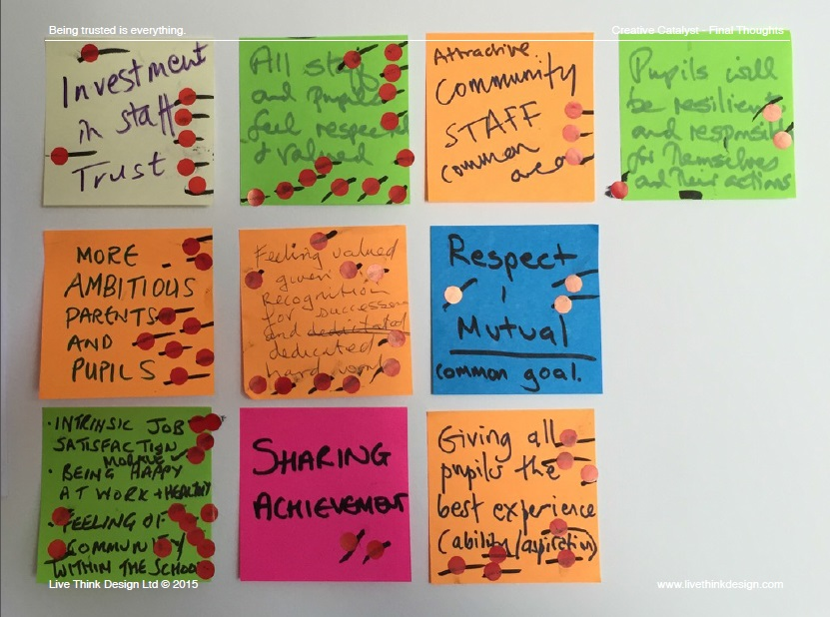
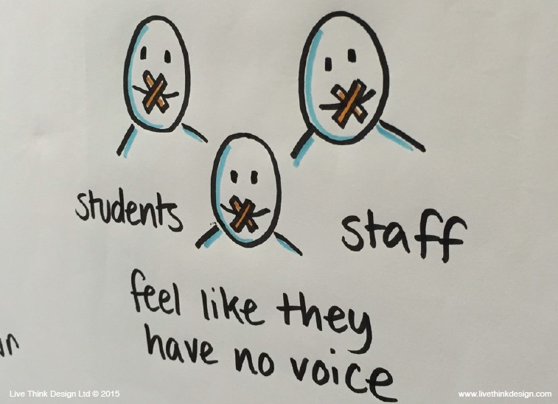
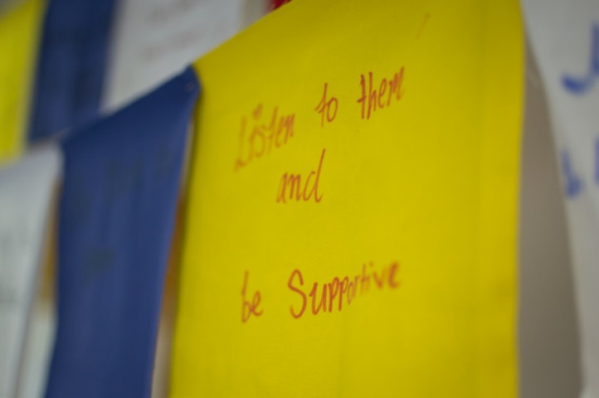
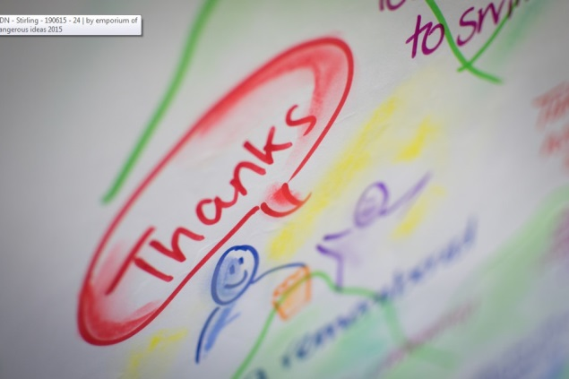

Slide 39
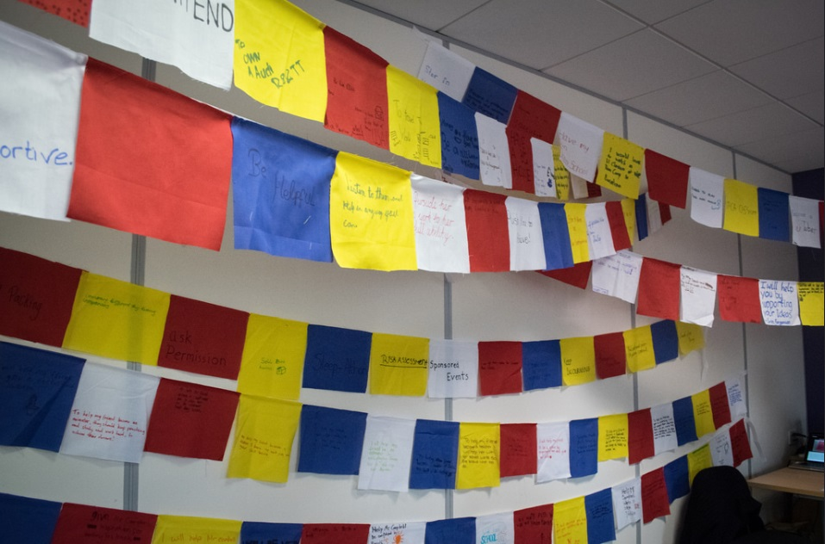
I Creative Catalyst
“You do need to make yourself vulnerable and be prepared to swap roles. [A] very bonding experience for a tutor class. I think the class gets more out of it if you tell your true dreams!!! So worth the risk…”
Educator
“V powerful. Excellent participation. [Pupils are] lovin it! They are helping me with my own creative change!!!!”
Educator

Slide 40
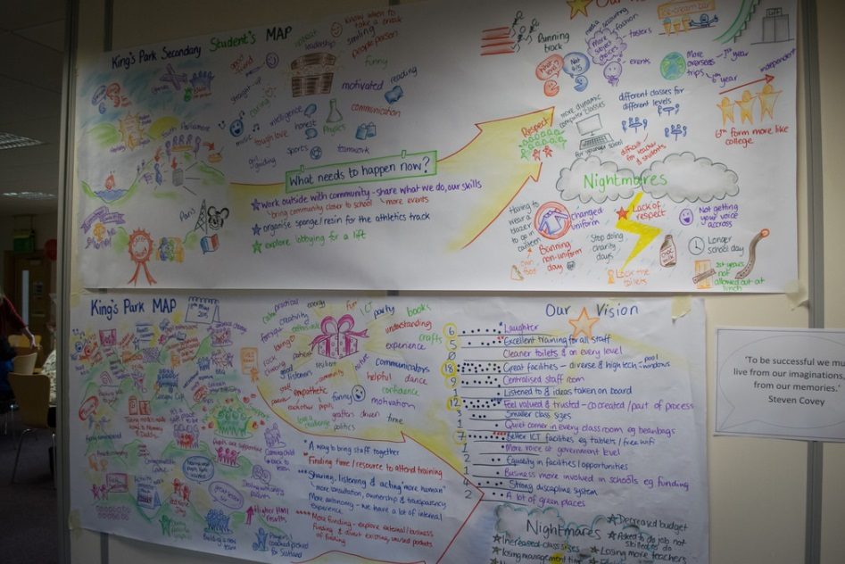
“One teacher used the Creative Conversation tool for creative writing without any prompting from the catalysts. I believe this shows the desire to be creative in us all, however we can’t start with a blank canvas we must have parameters or we get paralysed by choice.”
Creative Catalyst
“We used graphic facilitation to develop maps of the teachers’ proudest moments, gifts and skills, aspirational visions and nightmare visions. These were condensed into a mini-plan for improvement.”
Creative Catalyst

Slide 41
The 5 Whys
Why should we challenge prejudice based bullying?
Flip the Meaning
What if the aim of today was to support prejudice based bullying?
Polarise
What is the worst thing we could do?
What if?
The sole purpose of education was to end prejudice?

Slide 43
3 Key messages
Developing creativity skills can undermine prejudice at a fundamental level
Developing creativity skills is a responsibility for all and identified by inspectors
By using creative approaches the solutions to prejudice based bullying can be unexpected

Slide 44
Stephen Bullock, Development Officer, Creativity
Education Scotland
stephen.bullock@educationscotland.gsi.gov.uk
www.creativityportal.org.uk

